Slide 1
ATTENDENCE TRACKING SYSYTEM
USING CLOUD

Slide 2
REQUIRMENTS:
Asgiref
Boto3
Botocore
Django
django-cors-headers
Djangorestframework
Docutils
jmespath

Slide 3
Pytz
S3transfer
Six
Sqlparse
Urllib3
uuid

Slide 4
Attendance system tracking using the cloud refers to the use of cloud-based technology to manage and track employee attendance or student attendance. Cloud-based attendance systems offer several advantages over traditional manual or local server-based systems. Here's some information about attendance system tracking using the cloud:
Cloud-Based Infrastructure: Cloud-based attendance systems utilize cloud computing infrastructure to store and process attendance data. This eliminates the need for physical servers and allows for easy scalability and accessibility from anywhere with an internet connection.

Slide 5
Remote Access: With a cloud-based attendance system, administrators, managers, or authorized personnel can access attendance data remotely. This enables them to monitor attendance, generate reports, and make informed decisions even when they are not physically present at the location where attendance is being recorded.
Real-Time Updates: Cloud-based attendance systems provide real-time updates, ensuring that attendance records are updated instantly as employees or students check-in or check-out. This allows for accurate and up-to-date attendance information, eliminating delays or inconsistencies that may occur with manual or delayed data entry.

Slide 6
Biometric or Mobile Integration: Many cloud-based attendance systems support integration with biometric devices or mobile apps. Biometric devices such as fingerprint scanners or facial recognition systems can be used for secure and accurate attendance tracking. Mobile apps allow employees or students to mark their attendance using their smartphones, providing convenience and flexibility.
Automation and Notifications: Cloud-based attendance systems often include automation features that can simplify attendance management processes. They can automatically calculate work hours, overtime, and leave balances. Additionally, these systems can send automated notifications to employees or students regarding their attendance status, upcoming schedules, or any changes in the attendance policy.

Slide 7
Data Security and Backup: Cloud-based attendance systems typically offer robust data security measures, including encryption, access controls, and regular backups. Cloud service providers are responsible for maintaining the security and integrity of the data, reducing the burden on organizations to manage their own infrastructure and security protocols.
Integration with Other Systems: Cloud-based attendance systems can integrate with other HR or administrative systems, such as payroll, human resource management, or student information systems. This allows for seamless data sharing and reduces manual data entry, improving overall efficiency and accuracy.

Slide 8
Analytics and Reporting: Cloud-based attendance systems often provide advanced analytics and reporting capabilities. These systems can generate various reports, such as attendance summaries, trends, or compliance reports. Analytics features allow organizations to gain insights into attendance patterns, identify bottlenecks, and make data-driven decisions.

Slide 9
features of attendance tracking software
Clocking in and out
Time Tracking
Leave Management
Employee Scheduling
Overtime Calculation
Calendar Management
Self Service Portal
Payroll Integration
Reporting/analytics

Slide 10
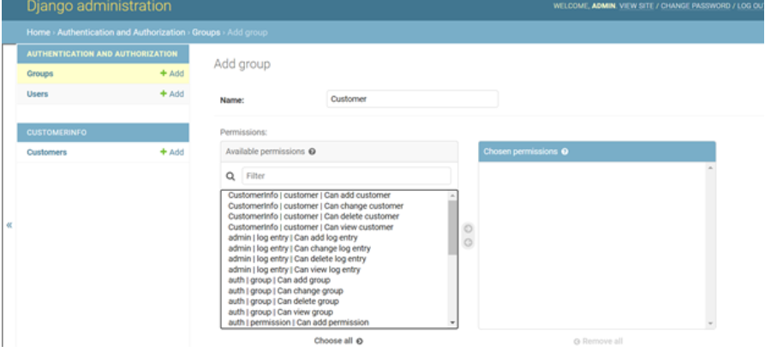
The steps are as follows:
Created a new group called ‘Customer’ via Django admin portal. (If needed create a new superuser which will be portal admin)

Slide 11
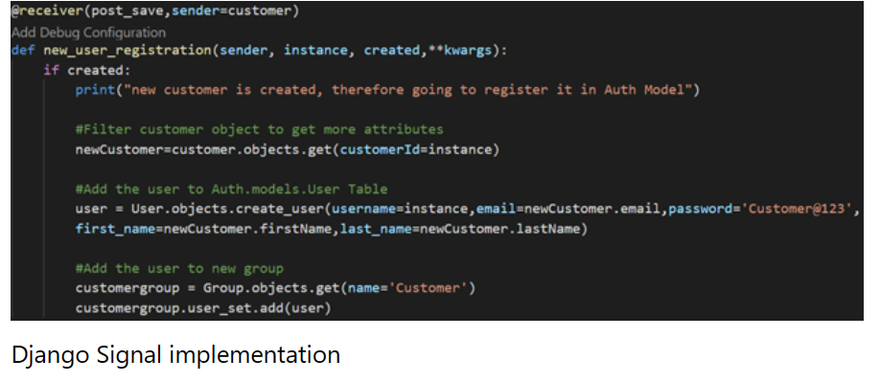
Added a signal which will be triggered whenever a new customer is added into the model. The signal will create a new user with that ‘CustomerId’ and enable it with a default password ‘Customer@123’

Slide 12
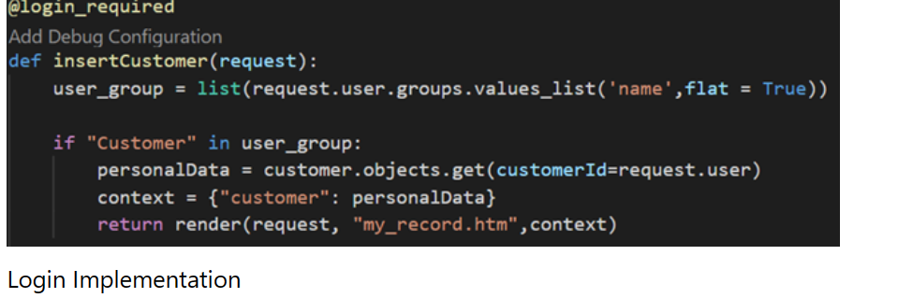
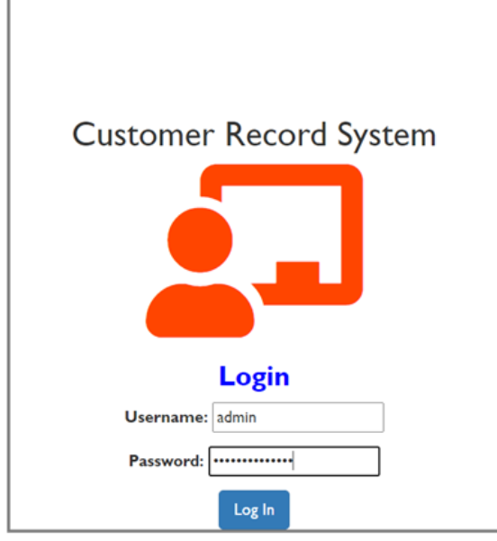
Add ‘Login_required’ in views, thereby only logged in users are allowed.
Login Portal will looks like below for both admin and customers,
Then customer can able to log into portal with their ‘Customer ID’ and the default password ‘Customer@123’

Slide 13
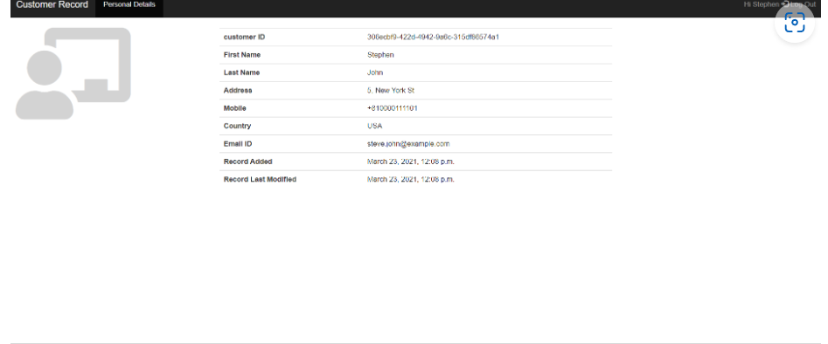
Customer Home Page

Slide 14
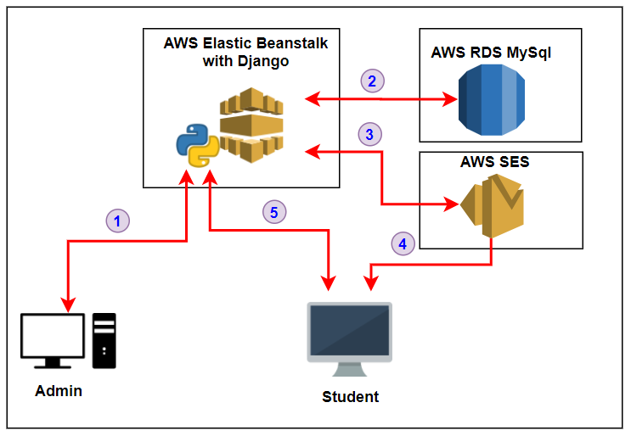

Slide 15
THANK YOU

